Slide 1
IBM University Engagement Project Submission
“Exploring the Power of Agentic AI with IBM Granite and LangFlow”

Slide 2

Project Tile – Agentic AI for Mental Health Awareness & Suicide Prevention
Domain of Project – Healthcare
Student Name | Recent Passport Photo | Email ID | Mobile number [WhatsApp]
Dr. Shubham Atmaram Narawade |  | shubhamn2606@gmail.com | 9158584584

Slide 3
Problem Statement -
Problem Statement : Agentic AI for Mental Health Awareness & Suicide Prevention
The Challenge
Mental health issues such as depression, anxiety, and suicidal thoughts are growing worldwide. Stigma, lack of awareness, and limited access to timely help prevent many individuals from seeking support. Traditional systems are often reactive, leaving gaps in early detection and preventive care.
The Objective
Build an Agentic AI-powered Mental Health Awareness & Suicide Prevention Agent that is empathetic, proactive, and safe. The solution should:
Promote Awareness & Education – Share accessible resources on mindfulness, coping strategies, and self-care.
Enable Early Detection (RAG) – Use Retrieval-Augmented Generation to identify distress signals in conversations, journaling inputs, or safe online data.
Provide Empathetic Support – Build a conversational agent that listens actively and responds with empathy (with clear disclaimers: not a substitute for professional medical advice).
Predict & Prevent Risks – Forecast stress peaks, suggest preventive strategies, and issue alerts when high-risk signals are detected (with consent).
Connect to Human Support – Link users to helplines, counselors, or community support for timely intervention.
Tech Stack (Mandatory)
LangFlow + IBM watsonx.ai + IBM Granite Models

Slide 4
Technology Used
Tech Stack (Mandatory)
Use any one of the following approaches:
LangFlow + IBM watsonx.ai + Granite Models
IBM Cloud Agentic Lab with IBM Granite Models
Replicate with LangChain + RAG + IBM Granite Models
I used LangFlow + IBM watsonx.ai + Granite Models

Slide 5
Proposed Solution -
Proposed Solution: Mind Guard Support Agent
The proposed solution is a AI-powered Mental Health Agent built using LangFlow, IBM watsonx.ai and Granite Models to provide personalized emotional support, mental health awareness and suicide prevention guidance. The system addresses challenges in mental health monitoring, emotional well-being support, and early crisis detection through an intelligent, modular architecture. At its core, the solution uses a LangFlow pipeline to fetch accurate mental health information from trusted sources such as WHO guidelines and psychological research datasets. This data is embedded and stored in a vector database, enabling the system to retrieve and summarize mental health insights such as stress management techniques, anxiety coping strategies, emotional regulation methods, and crisis warning signs using Granite models.
The system consists of four key agents:
Mental Health Knowledge Agent retrieves and summarizes mental health information using AI.
Mind Guard Support Agent provides personalized emotional support through conversation, mood reflection and journaling-based interaction to help users understand and manage their emotional state.
Wellness Recommendation Agent generates personalized mental wellness plans based on user inputs such as lifestyle, stress levels, sleep patterns and emotional condition.
Crisis Detection & Safety Agent identifies signs of severe distress or suicidal ideation and provides immediate safe responses, encouraging users to seek human support and guiding them toward appropriate crisis resources when required.
The solution includes a user-friendly dashboard that visualizes mood trends, emotional patterns and mental wellness progress over time. It also provides daily check-ins, coping strategy suggestions, mindfulness exercises, and emotional health insights.
LangFlow is used to orchestrate agent workflows, while watsonx.ai ensures scalable model deployment, embeddings and AI governance. Granite models power reasoning, empathetic response generation, summarization and personalization.
Overall, this solution delivers an end-to-end intelligent mental health assistant that promotes emotional well-being through awareness, personalized support, early risk detection and safe crisis intervention guidance.

Slide 6
Langflow component Used -
1) Chat Input – Interface where users enter their queries, preferences, or meal details (text/voice/image).
2) IBM watsonx AI Agent - Processes user input using Granite models to generate personalized nutrition insights and recommendations.
3) Name of IBM Granite model – Meta-llama/llama-3-3-70b → Fast, efficient for real-time diet recommendations
4) Chat output -Displays AI-generated responses such as diet plans, nutritional analysis, and health suggestions.

Slide 7
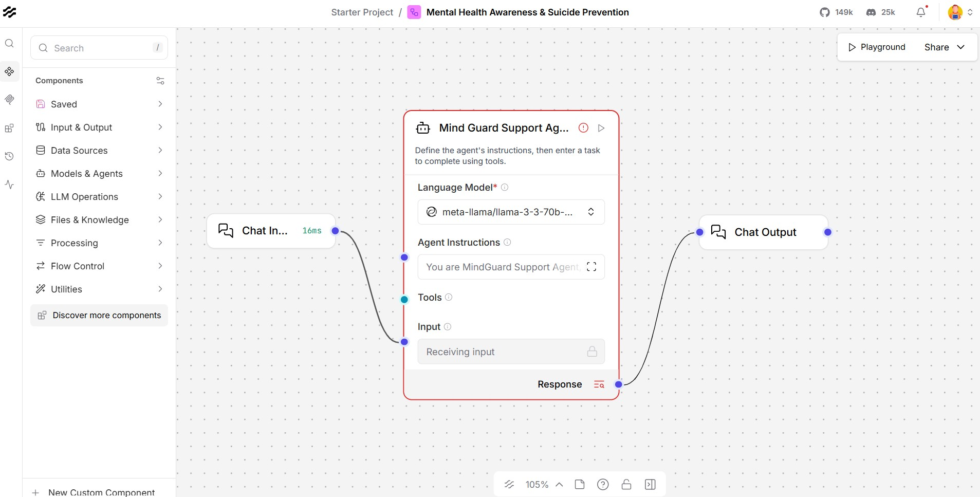
Langflow workflow -

Slide 8

Architecture blueprint

Slide 9

Role of Agentic AI in the solution
Role of Agentic AI in Mind Guard Support Agent
Agentic AI enables the Mind Guard Support Agent to operate as an intelligent, proactive support system rather than a simple conversational chatbot. Using IBM watsonx.ai and IBM Granite models, it coordinates multiple specialized agents to provide mental health awareness, emotional support, risk assessment, and crisis intervention guidance. Each agent is responsible for a specific task such as analyzing emotional sentiment, identifying signs of stress, anxiety, depression, or suicide risk, delivering mental health education, recommending coping strategies, and connecting users with appropriate support resources.
This multi-agent architecture ensures efficient task execution, accurate insights, and timely responses. Agentic AI brings strong context awareness by understanding user conversations, emotional patterns, personal challenges, and well-being goals, enabling highly personalized interactions. The system continuously adapts to real-time user inputs, monitoring changes in mood, behavior, or emotional state and adjusting recommendations accordingly. Agents collaborate and share information to improve decision-making, allowing the platform to provide comprehensive support while prioritizing user safety. In situations where signs of emotional distress or potential self-harm are detected, the agents work together to assess risk levels, encourage help-seeking behavior, and guide users toward professional mental health services, crisis helplines, or trusted support networks. Overall, Agentic AI makes the Mind Guard Support Agent proactive, empathetic, personalized, and goal-driven, functioning as a smart digital mental health companion that promotes emotional well-being, mental health awareness, and suicide prevention.

Slide 10
Technology Used
Langflow platform – For designing and orchestrating multi-agent workflows visually
IBM Grainte model – for eg – ibm-granite-3-2-8b – For natural language understanding, reasoning, and personalization
IBM Cloud – It provides the infrastructure to build, deploy, and scale the Nutrition Agent efficiently. IBM Cloud enables a reliable, secure, and scalable environment for deploying the Nutrition Agent.
IBM Watsonx.ai - For model deployment, embeddings, and AI governance
Vector Database (FAISS/Chroma) – For RAG-based nutritional data retrieval

Slide 11
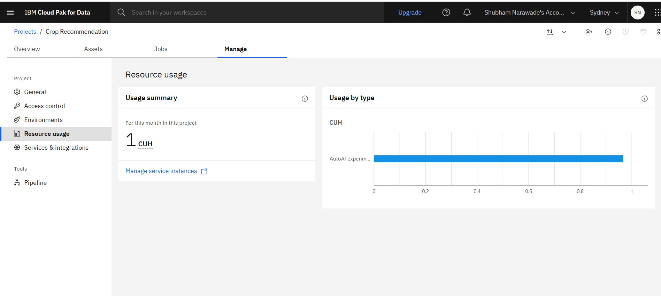
Token Usage
1 CUH used
·
·
·

Slide 12
Novelty and Uniqueness
The proposed Mind Guard Support Agent stands out by combining Agentic AI, RAG, and personalization into a single intelligent mental health support system.
Agentic Intelligence – Instead of a simple chatbot, the system works as an intelligent agent that understands user context and provides meaningful, empathetic, and situation-aware mental health support.
RAG-Based Accuracy – Integrates real-time retrieval of trusted mental health resources with AI generation, reducing misinformation and ensuring safe, evidence-based responses aligned with psychological guidelines.
Hyper-Personalization – Tailors emotional support and wellness suggestions based on user mood, stress levels, lifestyle patterns, and conversational context.
Real-Time Feedback Adaptation – Continuously adjusts responses based on ongoing user interactions and emotional state changes to provide relevant and timely support.
Multi-Modal Input – Supports text, voice, and optional image-based inputs for expressing mood, journaling, and emotional check-ins, improving accessibility and engagement.
Preventive Mental Health Focus – Goes beyond conversation by identifying early signs of stress, anxiety, or emotional distress and providing coping strategies and preventive guidance.
Scalable & AI-Driven Architecture – Built using Gemini 1.5 Flash, ensuring fast response time, scalability, and reliable real-time conversational performance.

Slide 13
Git Hub Link
Please create public github repository (Enable Add README button while creating repository) with format –
Please test and Paste the working Github URL – https://github.com/ShubhamShivNarawade/IBM-Project.git
Make sure you have Uploaded following three files into your github repository 1) app.json file , 2) yourproblemstatement.pdf file 3) your projectpresntation.pptx file 4) any other files
·
·
·

Slide 14
Future Scope
1. Integration with Wearables & Health Monitoring Devices
The system can be integrated with smartwatches, fitness bands, and health monitoring devices to collect real-time wellness data such as heart rate, sleep quality, physical activity, and stress indicators. By analyzing these metrics alongside user interactions, the Mind Guard Support Agent can detect potential signs of mental distress, emotional burnout, or changes in well-being. This integration will enable more personalized mental health recommendations, early risk identification, and proactive support based on the user's overall physical and emotional state.
2. AI-Powered Voice Assistant & Multilingual Support
Enhancing the platform with a voice-enabled AI assistant and multilingual capabilities will make mental health support more accessible and inclusive. Users will be able to communicate naturally through voice conversations in their preferred language, reducing barriers to seeking help. This feature can improve engagement for individuals who may find typing difficult or who are more comfortable expressing emotions verbally. Multilingual support will allow the system to reach diverse communities and provide culturally relevant mental health awareness and suicide prevention guidance.
3. Early Suicide Risk Prediction & Crisis Intervention
Future versions can incorporate advanced predictive AI models that analyze behavioral patterns, emotional sentiment, and conversation history to identify early warning signs of self-harm or suicidal ideation. The system can then provide timely interventions, personalized coping strategies, and recommendations to contact trusted individuals, mental health professionals, or crisis support services when necessary, helping to improve safety and prevention outcomes.
4. Personalized Mental Wellness Programs
The Mind Guard Support Agent can offer customized wellness plans based on a user's emotional state, stress levels, and mental health goals. These programs may include mindfulness exercises, meditation sessions, breathing techniques, mood tracking, journaling activities, and cognitive behavioral therapy (CBT)-inspired exercises. Continuous adaptation based on user progress will help promote long-term emotional well-being and resilience.
·
·
·

Slide 15


